Slide 1
Data Structures/Big Data
Chulalongkorn University
School of Integrated Innovation
Fall 2023
Marko Niinimaki, marko.n@chula.ac.th

Slide 2
From last week
Relational databases.
Building a Google Cloud database.
Importing data (company).

Slide 3
From last week
Connecting to my database (gcloud sql connect)
What are my databases (show databases)
Use one of them (use company)
What kind of tables are there (show tables)
List all the content of a table (select * from ..)

Slide 4
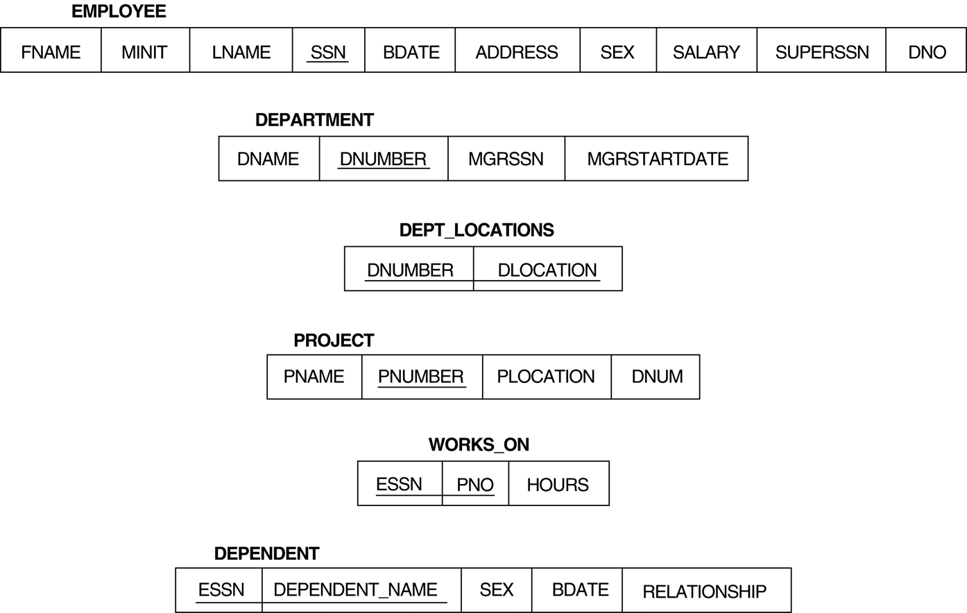
Today: Lots of “find out” with the company database.
The database structure looks like this. Keys for each table are underlined.
What are keys? Values that are known to be unique for a row of data in the table.
For example: 2 employees cannot have the same SSN (social security number).

Slide 5
Keys
A reference of a key to another table: foreign key.
Department’s Dnumber reference in Employee “Dno” is a foreign key.
The principle of “referential integrity”: If there is a foreign key, the key must have a corresponding value.
Example: You cannot have number 7 as dno in employee is there is no dnumber 7 in department.

Slide 6
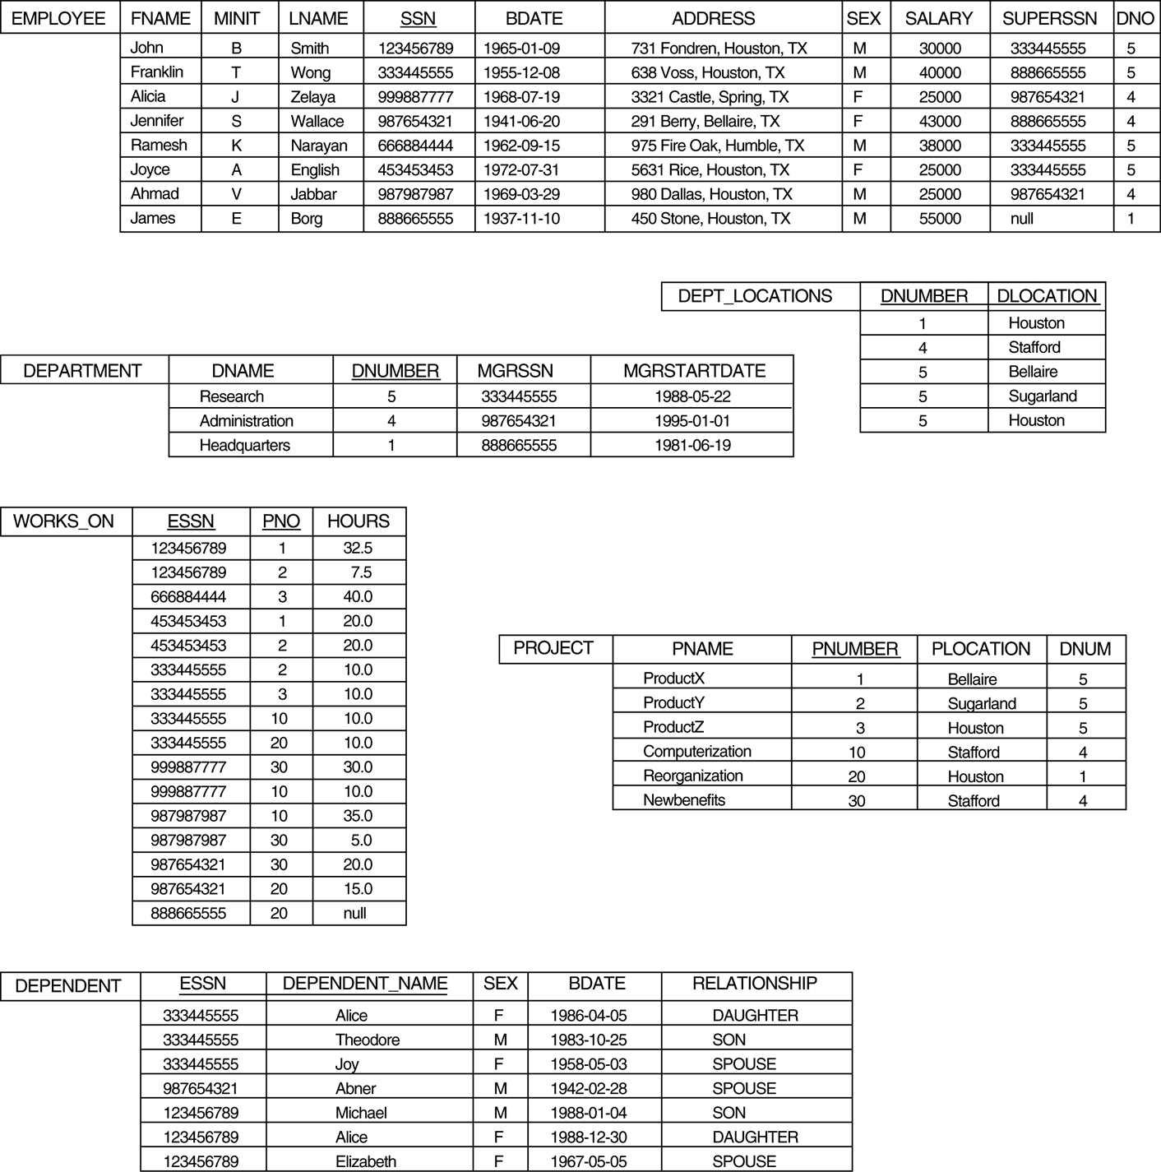
The database content looks like this.

Slide 7
Today: Lots of “find out” with the company database.
The SQL language cheat sheet:
https://learnsql.com/blog/sql-basics-cheat-sheet/sql-basics-cheat-sheet-a4.pdf
Don’t forget: in MySQL queries are terminated by “;”.
Let’s apply the cheat sheet’s tricks to our current database:
1 List all employees.
2 List the surnames of all the employees.
“Aggregates” like max. 3 Who is the oldest employee?
4 Who has the lowest salary?
5 What is the average salary?
Query structure:
select <columns>
from <tables>
where <conditions> ;

Slide 8
Today: Lots of “find out” with the company database.
Combine information from multiple tables.
6 Combine employee and department, but only show the department’s name and the employee’s surname.
7 List the surnames of employees who work on project “ProductY”.
8 Using “not” List the surnames of employees who do not work on project “ProductY”.

Slide 9
Today: Lots of “find out” with the company database.
More keywords: distinct, like
9 List all the department locations but do not repeat them.
10 List all employees who live in Houston.

Slide 10
Today: Lots of “find out” with the company database.
More keywords: alias or “join with itself” (difficult)
11 List all employees and their supervisors.

Slide 11
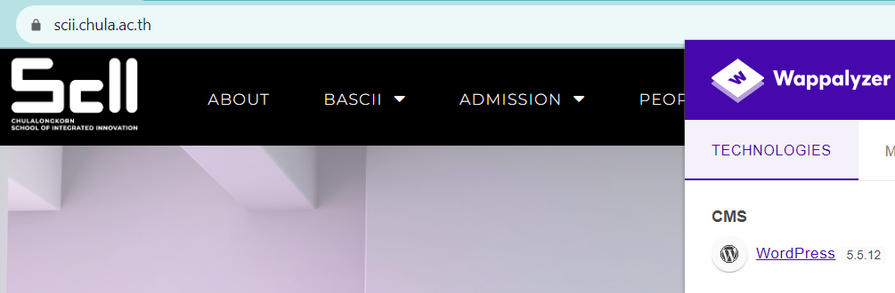
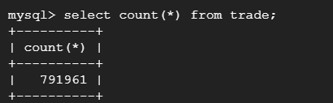
What next?
Assignments
Database programming. If the only way to communicate with a database was SQL, people would get frustrated. But scii.chula.ac.th has a MySQL database behind the scenes.
Much bigger databases.

